Slide 1

CYBV 480 Cyber Warfare
Week 1
Cyber Operations Overview
Cyber Kill Chain

Slide 2
Agenda
Fundamentals of Offensive and Defensive Cyber Operations and the Cyberspace Domain
Fundamentals of the Cyberspace Domain
Describe and Evaluate the Cyber Kill Chain
Explain how the Cyber Kill Chain can be used to describe and evaluate offensive Cyber Operations
Identify and evaluate the problems related to using the Cyber Kill Chain model when designing and implementing a cyber defense plan
Perimeter-defense focus
Malware-prevention focus

Slide 3
Key Definitions
A wall of text from DoD Joint Publications 3 – 12:
https://www.jcs.mil/Portals/36/Documents/Doctrine/pubs/jp3_12.pdf
Cyberspace
A global domain within the information environment consisting of the interdependent networks of information technology infrastructures and resident data, including the Internet, telecommunications networks, computer systems, and embedded processors and controllers
Defensive Cyberspace Operations
Passive and active cyberspace operations intended to preserve the ability to utilize friendly cyberspace capabilities and protect data, networks, net-centric capabilities, and other designated systems
Offensive Cyberspace Operations
Cyberspace operations intended to project power by the application of force in or through cyberspace
Defensive cyberspace operation response action
Deliberate, authorized defensive measures or activities taken outside of the defended network to protect and defend Department of Defense cyberspace capabilities or other designated systems

Slide 4
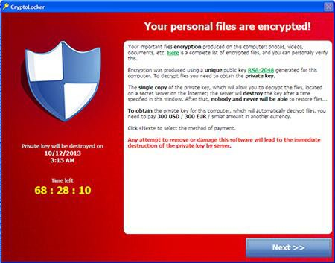
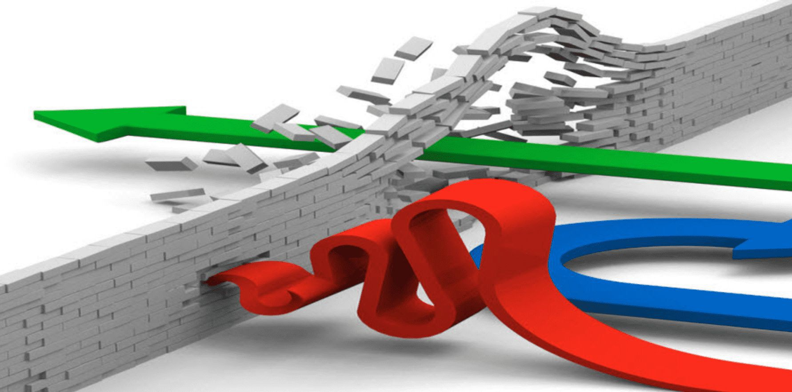
Cyber Activities
Malicious / Offensive
Non-Malicious / Defensive
Attacks
Crime
Espionage
Hactivism
Terrorism
Vandalism
Cyber Reconnaissance
Information Operations
Crime as a Service (CaaS)
Cyber Crime Support Infrastructure
Penetration Testing
Vulnerability Assessments
Security Audits

Slide 5
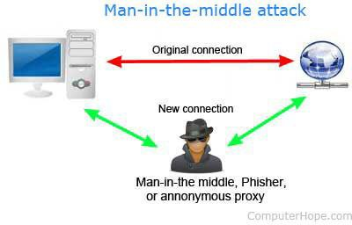
Types of Attacks
Network-Based Attacks
Attacks against the network infrastructure
Exploitation
Denial of Service (DoS) / Distributed Denial of Service (DDoS)
Man–in–the–Middle (MitM)
Server (Service) – side Attacks
Client – side Attacks
Social Engineering

Slide 6
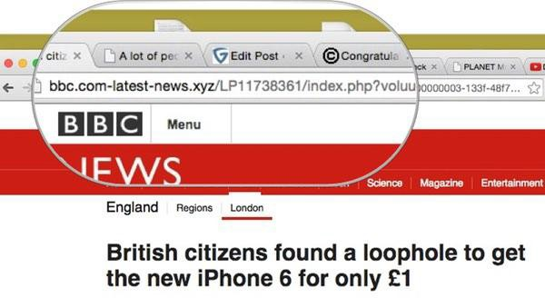
Types of Attacks
Network-Based Attacks
Client – side Attacks
Endpoint Attacks
Drive by Downloads
Media Drops
Waterholing Attacks
DNS Poisoning
Ransomware
Social Engineering

Slide 7

Types of Attacks
Network-Based Attacks
Client – side Attacks
Social Engineering
In-Person Attacks
Phone-based Attacks
Communication-based Attacks
Phishing / Minnows / Whaling

Slide 8

Hacker Mindset
Hackers don’t care:
About your project’s scope
It’s managed by a third party
It’s a legacy system
It’s “too critical to patch”
About your budget
About non-disclosure agreements
It wasn’t a requirement in the contract
It’s an internal system
It’s really hard to change
You’re not sure how to fix it
It’s handled in the cloud
About your risk registry entry
It’s an interim solution
It’s [insert standard here] compliant
It’s encrypted on disk
The cost benefit doesn’t stack up
You can’t explain the risk to “The Business”
You’ve got other priorities
You can’t show Return on Investment

Slide 9
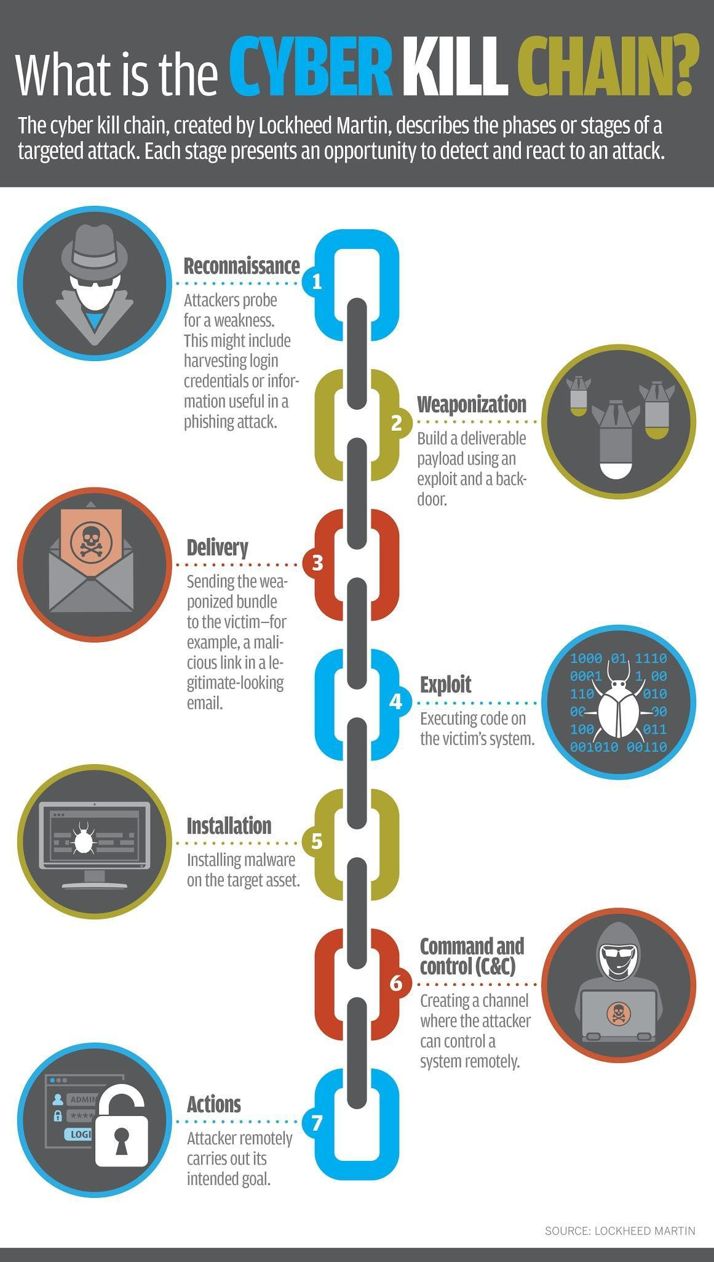
Cyber Kill Chain
Reconnaissance
Weaponization
Delivery
Exploitation
Installation
Command and Control
Actions on Objectives

Slide 10
Cyber Kill Chain
What is the Cyber Kill Chain?
How do we use it?
Mandatory and optional readings

Slide 11
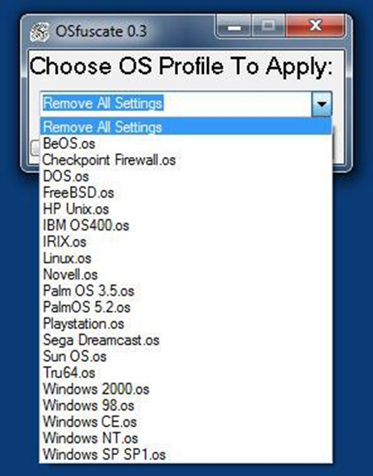
Cyber Kill Chain
Reconnaissance
Offense
!!! Most Important Phase !!!
Pre-exploitation
OSINT
HUMINT
Etc
Post-exploitation
Foothold
Pivot
Defense
Instrument defenses for detecting probing
Minimize public footprint
Red team yourself!
Tools / Techniques
Infinite recursion (Spider Traps)
False fingerprinting (OSfuscate)

Slide 12

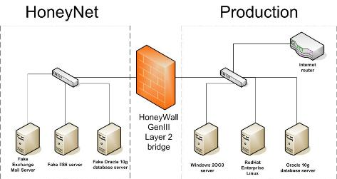
Cyber Kill Chain
Weaponization
Offense
Develop exploit using knowledge from recon
Re-use existing capability
Design exploit in-house
Buy
Defense
Patch, patch, patch
Follow threat intel sources
Minimize the attack surface
Tools / Techniques
Honeypots
Honeynets

Slide 13

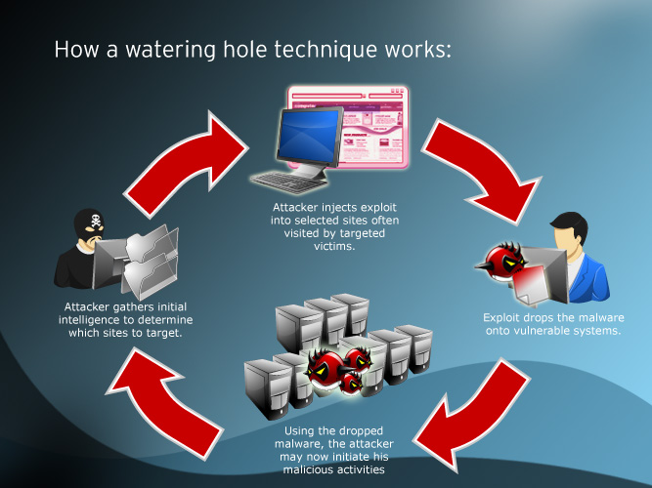
Cyber Kill Chain
Delivery
Offense
Phishing
Watering Hole
Social Engineering
Webex / Netex
Defense
Minimize Privileges
Combine network and host forensics
Develop “antidote” and share
Determine Adversary TTPs and share
Tools / Techniques
Honeytraps to simulate success

Slide 14

Cyber Kill Chain
Exploitation
Offense
Successful delivery followed by successful attack
Defense
Layer Defenses
Sandboxing
Zero Clients

Slide 15
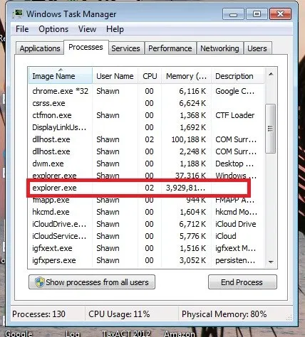
Cyber Kill Chain
Installation
Offense
Install in memory for temp access
Hide on disk for sustained persistence
Defense
Focus defenses on common install paths
Restoring an infected backup restores the infection

Slide 16
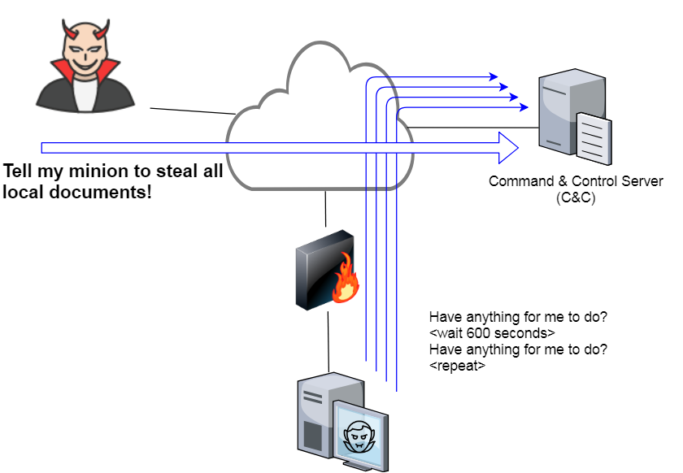
Cyber Kill Chain
Command and Control
Offense
Beacon or direct access control
Defense
Whitelist external traffic protocols and destinations
Kill switch?
Traffic analysis

Slide 17


Cyber Kill Chain
Actions on Objectives
Offense
Ransom
Steal IP or credentials
Destroy, tamper, corrupt / mine data
Gain legitimate access
Continue to Pivot
Defense
Develop and use IR playbook
Always updated / Attack don’t follow the rules
Good for level 1 IR
Whitelist lateral communication
Tools / Techniques
Honeytokens
Honeywords
Zip Bombs

Slide 18
Questions?
Coming Next Week
Mission Planning & Cyber Law

